Slide 1
Experiment design

Slide 2
1000ms
270ms
30ms
RADIO
30ms
Time
30ms
Man-made Natural
radio
500ms
RADIO PHONE
How well did you see the first stimuli?
On a scale of 1-4
1 2 3 4

Slide 3
Exp 1
Prime-target relation: Same word
Fixation 1000ms
Mask 270ms
Mask 30ms
RADIO
Prime 30ms
Mask 30ms
Artificial Natural
Time
radio
Categorization 0-1500ms
(Target present for 500ms)
RADIO PHONE
Recognition
How well did you see the first stimuli?
On a scale of 1-4
PAS
1 2 3 4

Slide 4
Exp 2
Prime-target relation: Same word
Fixation 1000ms
Mask 270ms
Mask 30ms
RADIO
Prime 30ms
Mask 30ms
Artificial Natural
Time
radio
Categorization 0-760ms
(Target present for 500ms)
RADIO PHONE
Recognition
How well did you see the first stimuli?
On a scale of 1-4
PAS
1 2 3 4

Slide 5
Artificial Natural
Exp 3
Prime-target relation: Same word
Fixation 1000ms
Artificial Natural
Mask 270ms
Artificial Natural
Mask 30ms
Artificial Natural
RADIO
Prime 30ms
Artificial Natural
Mask 30ms
Artificial Natural
Time
radio
Categorization 100-740ms
(Target present for 500ms)
RADIO PHONE
Recognition
How well did you see the first stimuli?
On a scale of 1-4
PAS
1 2 3 4

Slide 6
Artificial Natural
Exp 4
Prime-target relation: Same word
Fixation 1000ms
Artificial Natural
Mask 270ms
Artificial Natural
Mask 30ms
Artificial Natural
RADIO
Prime 30ms
Artificial Natural
Mask 30ms
Artificial Natural
Time
radio
Categorization 100-740ms
(Target present for 500ms)
RADIO PHONE
Recognition
How well did you see the first stimuli?
On a scale of 1-4
PAS
1 2 3 4

Slide 7
Exp 4
w/o art/nat and target circle on each slide
Prime-target relation: Same word
Fixation 1000ms
Mask 270ms
Mask 30ms
RADIO
Prime 30ms
Mask 30ms
Artificial Natural
Time
radio
Categorization 100-740ms
(Target present for 500ms)
RADIO PHONE
Recognition
How well did you see the first stimuli?
On a scale of 1-4
PAS
1 2 3 4

Slide 8
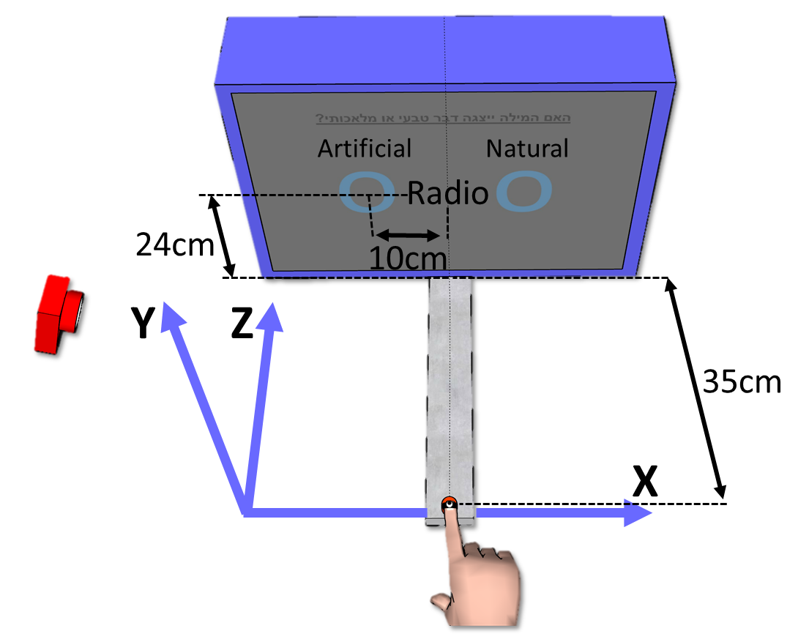
Fixation 1000ms
Mask 270ms
Mask 30ms
RADIO
Prime 30ms
Mask 30ms
Artificial Natural
Time
radio
Categorization 100-740ms
(Target present for 500ms)
RADIO PHONE
Recognition
How well did you see the first stimuli?
On a scale of 1-4
PAS
1 2 3 4

Slide 9
Artficial Natural
Prime-target relation: Different word
Fixation 1000ms
Artficial Natural
Mask 270ms
Artficial Natural
Mask 30ms
Artficial Natural
CLOUD
Prime 30ms
Artficial Natural
Mask 30ms
Artficial Natural
Time
radio
Target + Categorization 500ms
CLOUD TIGER
Recognition
How well did you see the first stimuli?
On a scale of 1-4
PAS
1 2 3 4

Slide 10
Prime-target relation: Different word
Task: Target categorization
Fixation 1000ms
Mask 270ms
Mask 30ms
RADIO
Prime 30ms
Mask 30ms
Time
radio
Target 500ms
Man-made Natural
Categorization
How well did you see the first stimuli?
On a scale of 1-4
PAS
1 2 3 4
Categor & Recog on different blocks

Slide 11
Prime-target relation: Different word
Task: Target categorization
Fixation 1000ms
Mask 270ms
Mask 30ms
CLOUD
Prime 30ms
Mask 30ms
Time
radio
Target 500ms
Man-made Natural
Categorization
How well did you see the first stimuli?
On a scale of 1-4
PAS
1 2 3 4
Categor & Recog on different blocks

Slide 12
Prime-target relation: Same word
Task: Prime recognition
Fixation 1000ms
Mask 270ms
Mask 30ms
RADIO
Prime 30ms
Mask 30ms
Time
radio
Target 500ms
RADIO PHONE
Recognition
How well did you see the first stimuli?
On a scale of 1-4
PAS
1 2 3 4
Categor & Recog on different blocks

Slide 13
Prime-target relation: Different word
Task: Prime recognition
Fixation 1000ms
Mask 270ms
Mask 30ms
CLOUD
Prime 30ms
Mask 30ms
Time
radio
Target 500ms
TIGER CLOUD
Recognition
How well did you see the first stimuli?
On a scale of 1-4
PAS
1 2 3 4
Categor & Recog on different blocks

Slide 14
Prime-target relation: Same word
Fixation 1000ms
Mask 270ms
Mask 30ms
RADIO
Prime 30ms
Mask 30ms
Time
radio
Target 500ms
Man-made Natural
Categorization
RADIO PHONE
Recognition
How well did you see the first stimuli?
On a scale of 1-4
Categor & Recog on same block
PAS
1 2 3 4

Slide 15
Prime-target relation: Different word
Fixation 1000ms
Mask 270ms
Mask 30ms
CLOUD
Prime 30ms
Mask 30ms
Time
radio
Target 500ms
Man-made Natural
Categorization
CLOUD TIGER
Recognition
How well did you see the first stimuli?
On a scale of 1-4
Categor & Recog on same block
PAS
1 2 3 4

